Slide 1
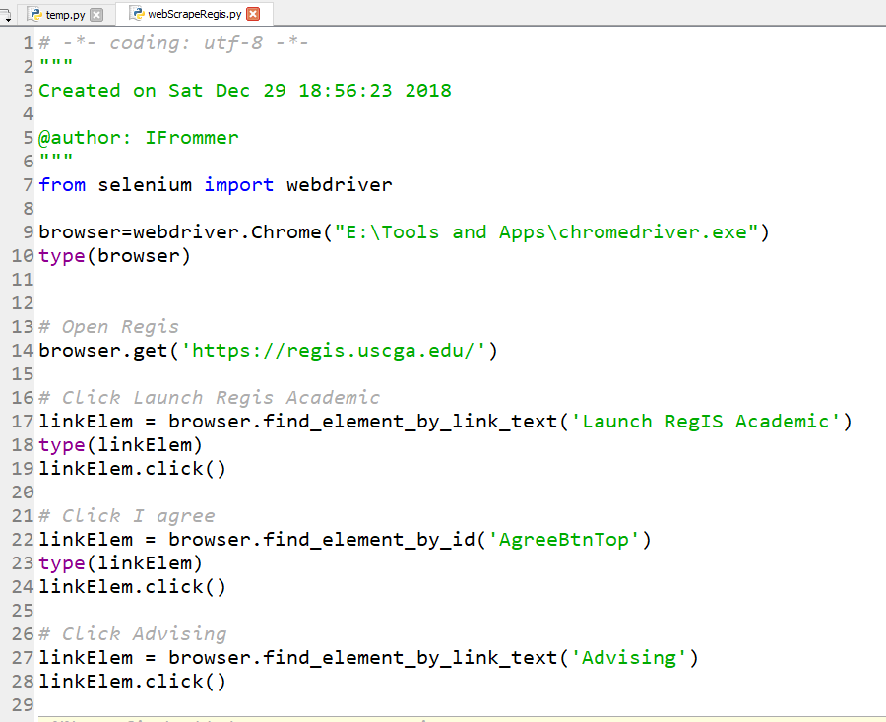
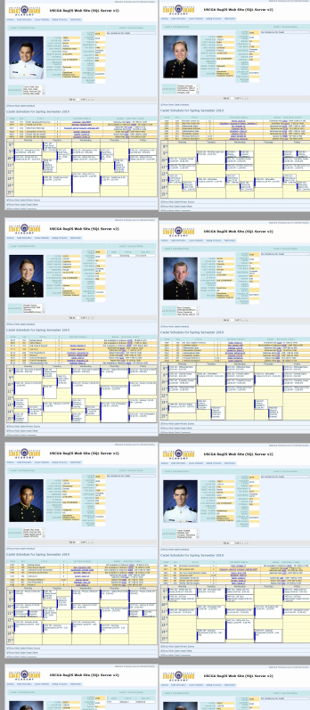
REMOTE CONTROL REGIS

Slide 2
Web Scraping with Python
Info Sys

Slide 3
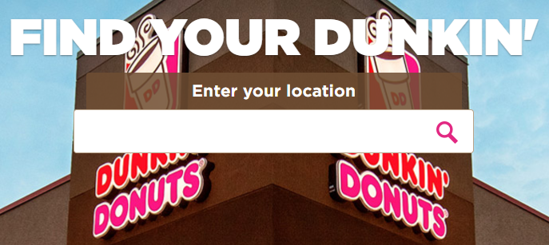
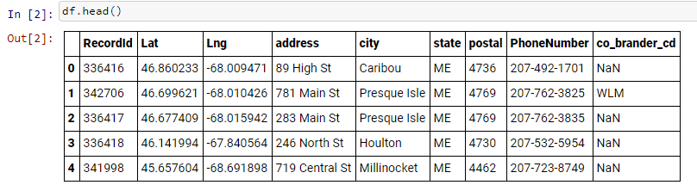
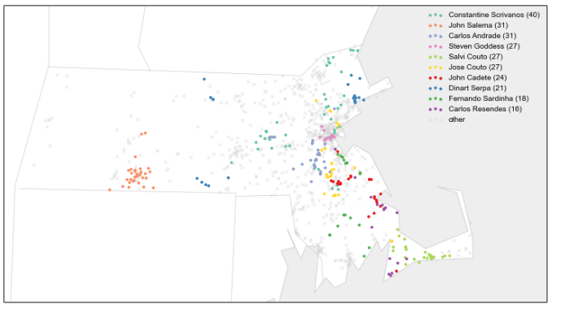
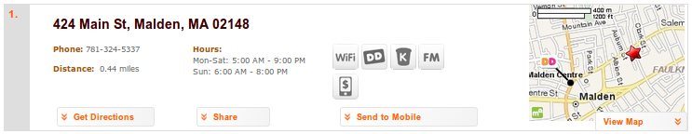
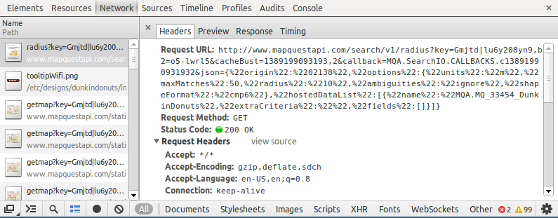
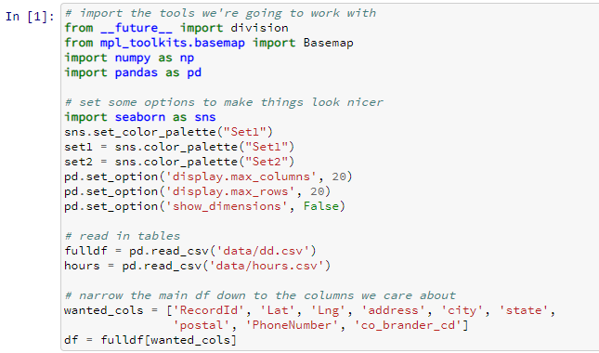
We saw web scraping before…
Scrape the html page with Python
Notes:
Webscraping in python

Slide 4
Today
HTML - brief introduction
Beautiful Soup Python Web Scraping - introduction
Example - scraping NFL football quarterback data
Tutorial for you to work on and complete for HW
Check out links files in this lecture’s folder on the course repo for helpful sources on HTML and Web Scraping.

Slide 5
Data From the Internet
Have you ever retrieved data from the Internet?
We have seen/used several data sets from the Internet already:
  NYC 311
  Bike data
  Drug deaths
  Baby names

Slide 6
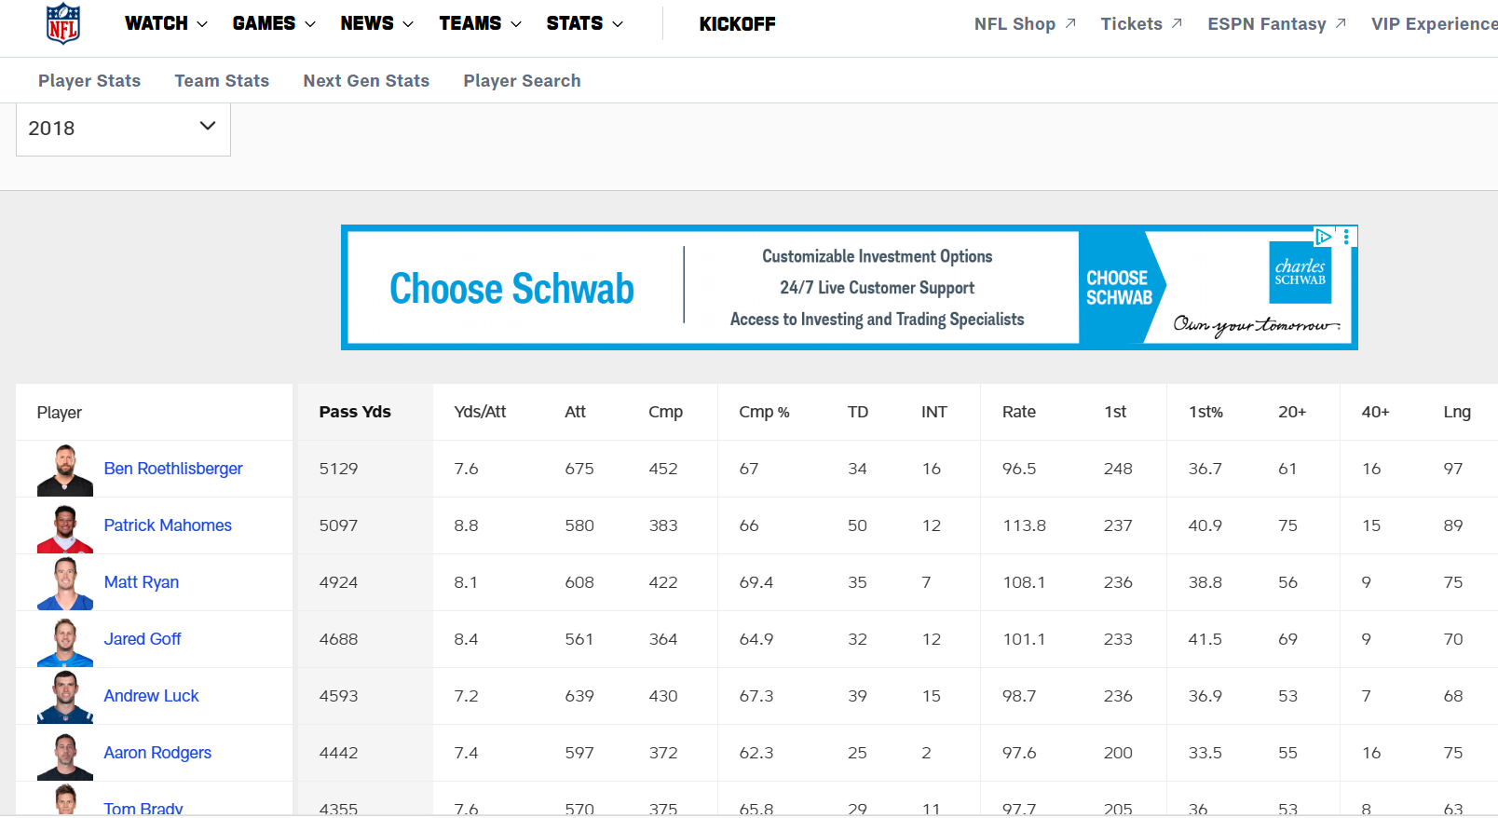
Data From the Internet
What if the data you want is not already in a convenient file format like .csv?
e.g. Quarterback stats from an NFL.com web page
…
or that NFL data from the website for ALL previous years...
** Now instead of retrieving an existing data set, we construct our own through a series of web requests.
Source: https://www.nfl.com/stats/player-stats/category/passing/2018/reg/all/passingyards/desc

Slide 7
Web Scraping
parse
analyze (a sentence) into its parts and describe their syntactic roles.
[computing] analyze (a string or text) into logical syntactic components, typically in order to test conformability to a logical grammar.
src: https://languages.oup.com/google-dictionary-en
Web scraping - using a program to automatically download and process content from the World Wide Web*
Web scraping in Python requires:
  Familiarity with HTML (what web pages are written in)
  A web scraping library
  – we will use Beautiful Soup
  - HTML / XML parser
  - Documentation:
  (Very helpful)
https://www.crummy.com/software/BeautifulSoup/bs4/doc/
* From Automate the Boring Stuff with Python by Al Sweigart
Notes:
Parsing means analyzing and identifying the parts of

Slide 8
Web Scraping
Web scraping - using a program to automatically download and process content from the World Wide Web*
Web scraping in Python requires:
  Familiarity with HTML (what web pages are written in)
  A web scraping library
  – we will use Beautiful Soup
  - HTML / XML parser
  - Documentation:
  (Very helpful)
https://www.crummy.com/software/BeautifulSoup/bs4/doc/
* From Automate the Boring Stuff with Python by Al Sweigart
Notes:
Parsing means analyzing and identifying the parts of

Slide 9
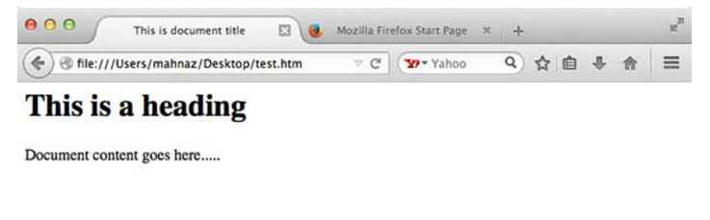
HTML – hypertext markup language
HTML is used to design/layout websites
These instructions
Instruct the browser how the text/information should be displayed
<!DOCTYPE html>
<html>
<head>
<title>This is document title</title>
</head>
<body>
<h1>This is a heading</h1>
<p>Document content goes here.....</p>
</body>
</html>
https://www.tutorialspoint.com/html/index.htm

Slide 10
HTML
Let’s go ahead and make a .htm file.
Open Notepad (type Notepad in the Windows Start search box)
We’ll write some HTML.
If we save this file with a .htm extension, your computer should default to opening in your browser.

Slide 11
HTML Example 1
<strong>Hello World</strong>

Slide 12
HTML Example 2
<html>
<head>
<title> This is the title! </title>
</head>
<body>
This is the body of the page.
<h1>Here is a heading level 1</h1>
<h2>And this is a heading level 2</h2>
<p> The p tag is used for paragraph level text</p>
<a href='http://www.uscga.edu'>CGA Web Site</a>
</body>
</html>

Slide 13
HTML
Consists of Tags, Attributes and Strings (and other things, but we’re going to keep it basic for now)
Many useful websites exist for learning more about HTML if you are interested (see links files in this lecture’s folder on the course repo for helpful sources)
Our plan in learning HTML:
  cover some basic information first, then
  learn as we go through some web scraping examples
You are highly encouraged to explore on your own

Slide 14
HTML Basics
this was some html code from our Example 2:
Opening Tag
Closing Tag
<a href='http://www.uscga.edu'>USCGA Web Site</a>
Attribute
Content (string)
All of this together is referred to as an element

Slide 15
HTML Basics https://developer.mozilla.org/en-US/docs/Learn/Getting_started_with_the_web/HTML_basics
Opening Tag
Closing Tag
<p> My cat is very grumpy </p>
Content (string)
All of this together is referred to as an element
<p class=“editor-note”>My cat is very grumpy</p>
Attribute

Slide 16
HTML
Common Tags:
<a> link
<p> paragraph
<div> indicates division or area of the page
<b> bolds any text inside
<i> italicizes any text inside
<table> creates a table
<form> creates input form
An element can have multiple attributes:
** We use the tags, attributes, and ID’s of elements in order to find and retrieve the specific information we are interested in. **
<p class=“editor-note” id=“my id”>My cat is very grumpy</p>
Two attributes

Slide 17
Beautiful Soup: Process
  Make connection to the website of interest
  All of the html is retrieved at once
  Beautiful Soup library converts the html text into a Beautiful Soup object (bs4)
  Extract the information you want by parsing the html text using the bs4 objects and methods. Commonly used ones include:
    Objects: Tag, NavigableString, BeautifulSoup, Comment
    Methods:
      find()returns the first bs4 object that meets the criteria
      find_all()returns a list of all bs4 obj that meet the criteria
      get_text()returns just the text portion of the document or tag

Slide 18
Beautiful Soup Basics https://www.crummy.com/software/BeautifulSoup/bs4/doc/#get-text
Often need to interact with attributes:
  To access a Tag’s attributes, you can treat the tag like a dictionary:
<b id=‘boldest’> This ‘b’ tag has an attribute ‘id’ with a value ‘boldest’
tag[‘id’] This would return ‘boldest’ (treats the tag obj as a dictionary)
  You can add, remove and modify tag attributes:
tag[‘id’] = ‘verybold’
tag[‘another-attribute’] = 1
Now the element would be:
<b another-attribute=‘1’ id=‘verybold’></b>

Slide 19
Learn by Example:
Now, will learn through an example of web scraping NFL quarterback data…

Slide 20
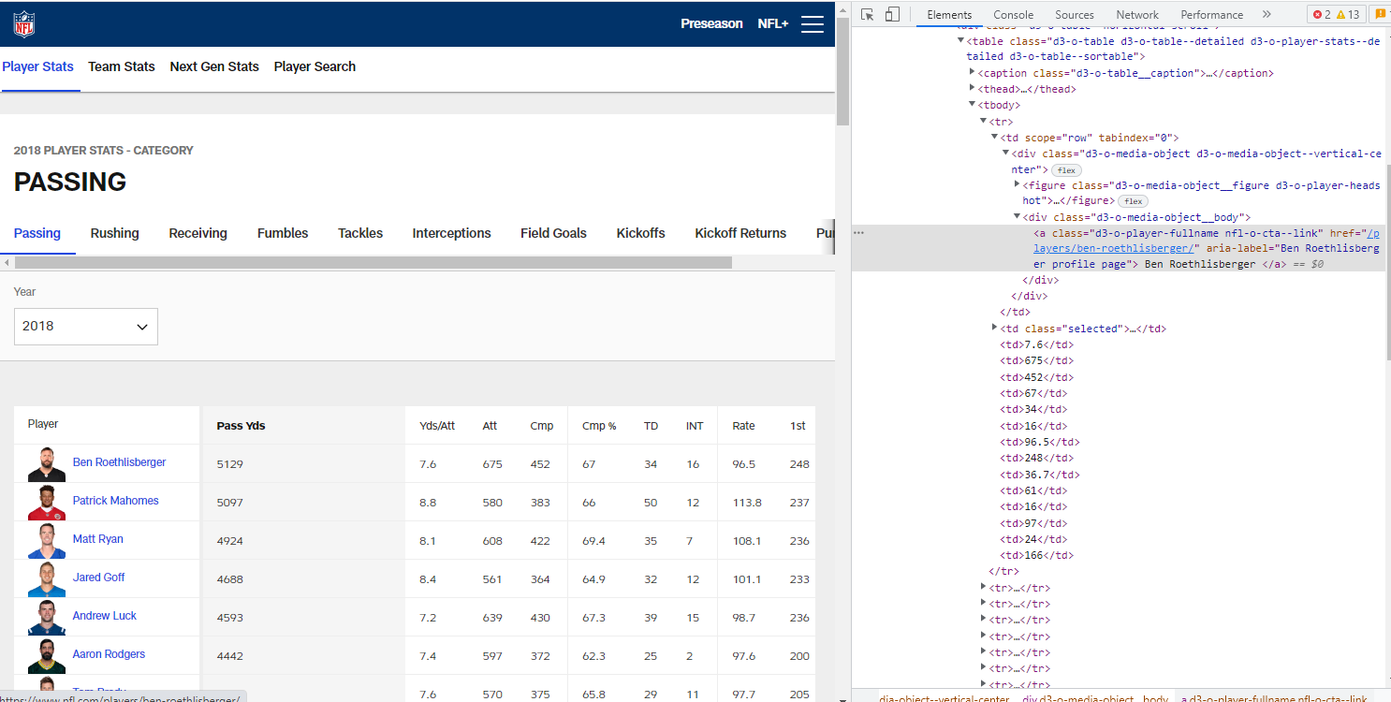




the web page: its html source code:

Slide 21





Slide 22
A Warning about Web Scraping
Many web sites are “dynamically rendered”, which may cause Beautiful Soup to fail
In addition, web sites may change the way their pages are rendered over time
  web scraping code that worked may later fail on the same site
Work-arounds include
  experimenting with the parser and content parameters in Beautiful Soup, i.e. changing this line:
  soup = BeautifulSoup(website.content, 'html.parser')
  using a different Python library like Selenium, which allows you to take control of the browser through code (e.g. clicking, selecting, …)
  using a different language altogether, such as JavaScript

Slide 23
Now, YOU practice
Follow along with the tutorial in HW 3 Part I to scrape weather data.
Complete this tutorial and have a working program as part of HW 3
By the end of this tutorial you should be familiar with:
      Basic HTML nomenclature
      Basic HTML tags
      Basic Python code to open a web page, create a Beautiful Soup object
      Basic commands to loop through this Beautiful Soup object

